Slide 1


Landing page & AI

Slide 2
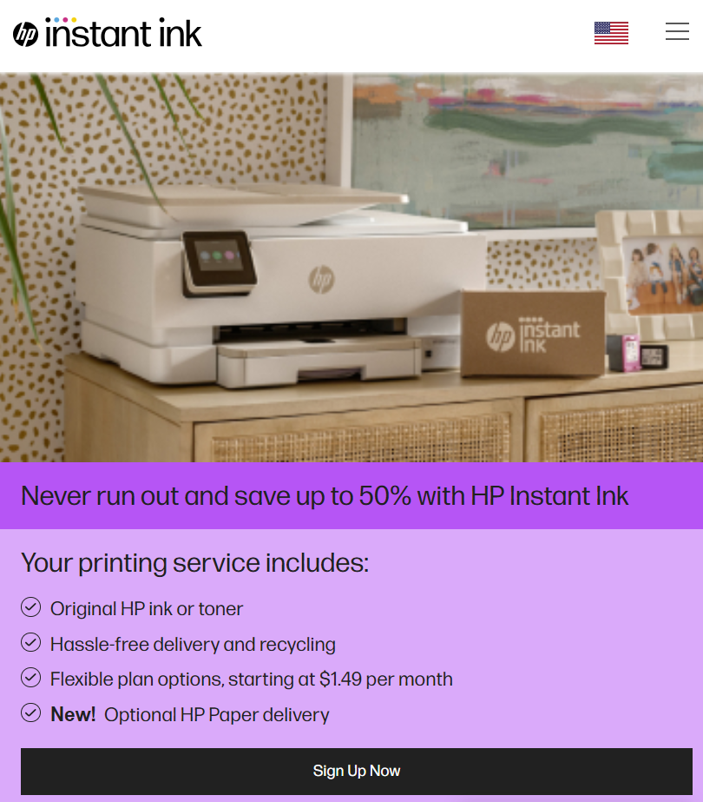
InstantInk Landingpage

Slide 3
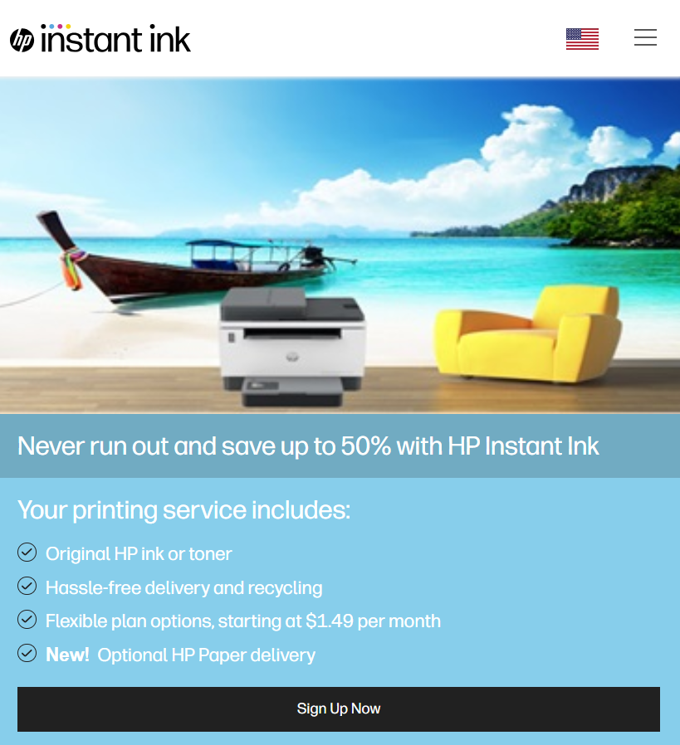
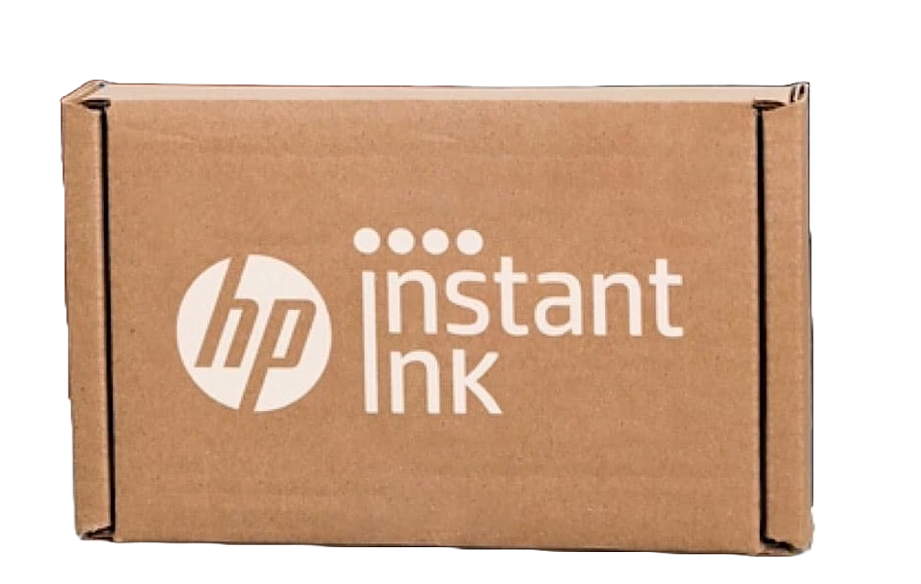
US light Summer View

Slide 4
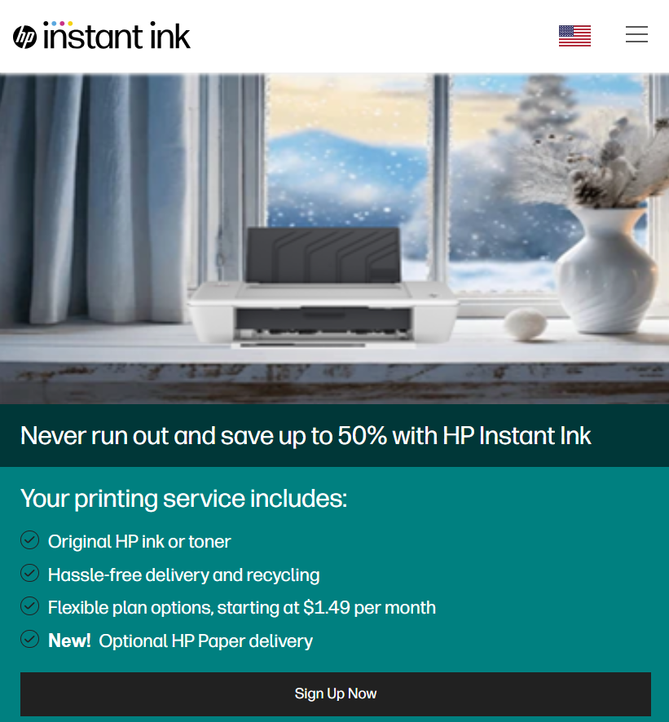
US true Winter view

Slide 5
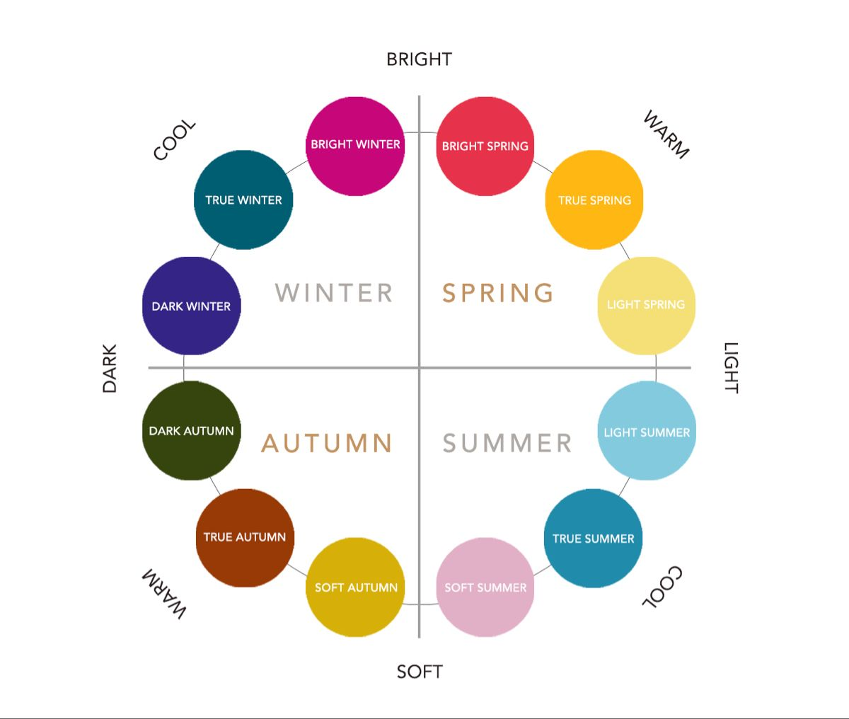
LP AI Model
fed

Slide 6

HEX-CODE / Image / Styles
LP AI Model
Seasons / Context

Slide 7
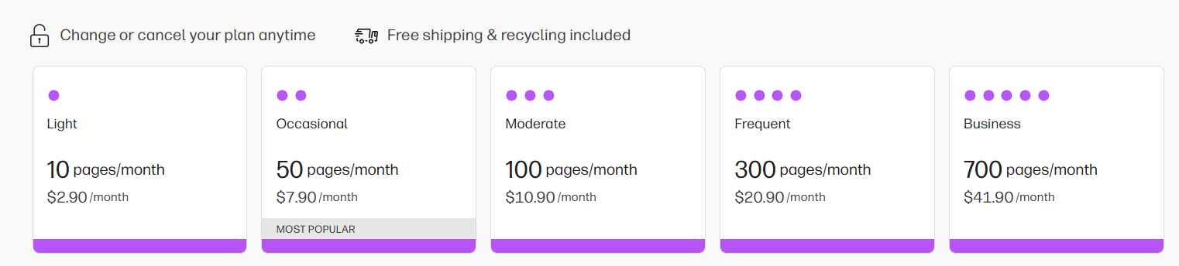
Offering area centric most popular plans

Slide 8
Can improve customer satisfaction through personalization
AI can deliver to individual customers :
personalize content
Messaging
Ads
Recommendations
AI-powered virtual agents are always available.
AI programs do not need to sleep or take breaks, providing 24/7 service

Slide 9
Tensorflow
Mongodb

